Slide 1
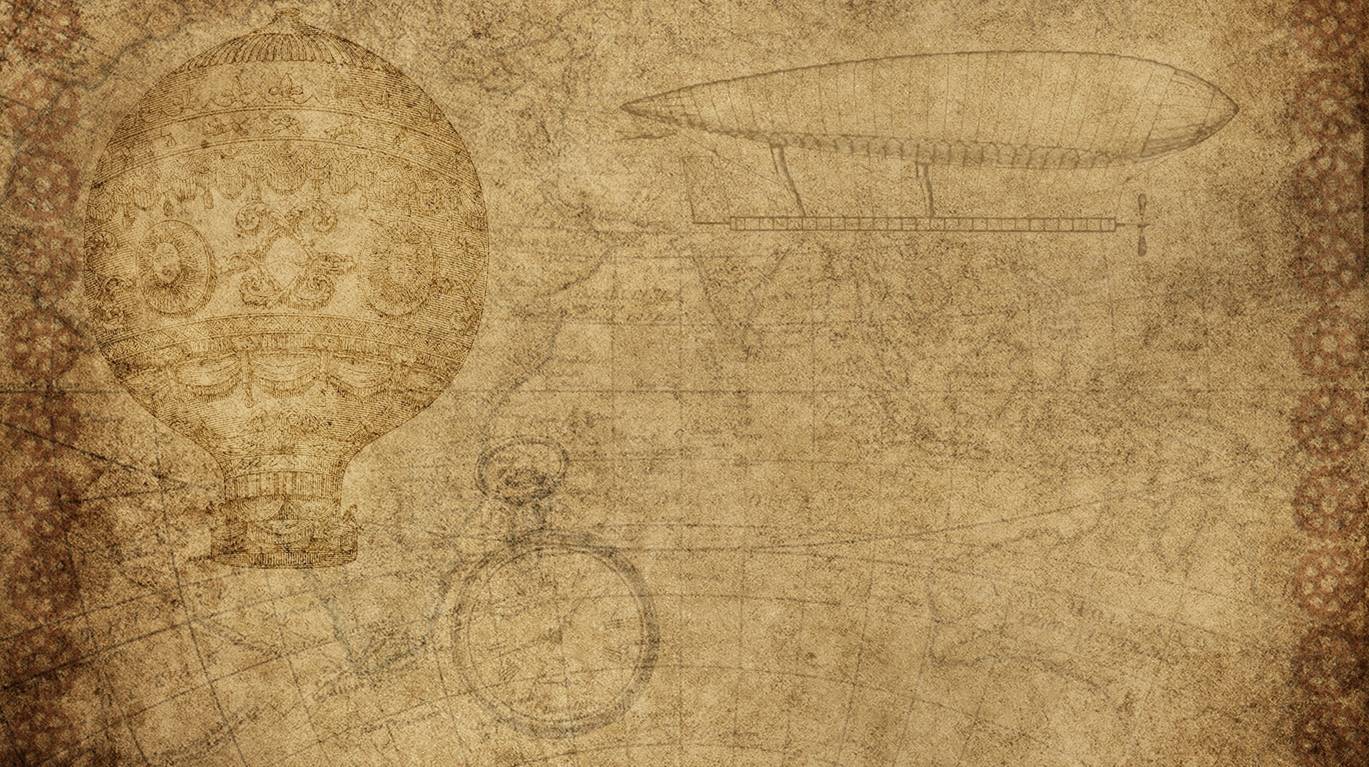

SKIN DISEASE IDENTIFICATION USING IMAGE ANALYSIS
Team – 07
Team members
Abhinav kumar Pathak
Abhilash anand
Rishi Sharma
Himanshu Shekhar

Slide 2

Introduction
The main motive of this project is to develop a model that can be used to predict the difference in different type of skin disease. In our model we have included 5 types of diseases that are
1) Acne
2) Eczema
3) Measles
4) Melanoma
5) Psoriasis
We have also developed a website to host it and make it as real-life solution.

Slide 3

Problem statement
The heavy dependencies on medical expert for medical image diagnosis analysis are a serious challenge for regions (especially Low and Medium Income Countries) where the expert might not be readily available, inadequate or nonresponsive to an urgent medical need (such as dermatological-related).
The aforementioned problems suggest that a better and manageable solution is needed urgently with the view to minimize these dependencies and human bias, thus leading to our research question.

Slide 4

Proposed solution
The purpose of the study is to design and model a system that uses medical imaging to reduce heavy dependencies on medical expert for diagnosis procedure of PSL (especially melanoma and psoriasis) in patients.
To ease diagnosis and treatment of skin patient (by means of automation) and provide for cost effective way of treatment (by using devices or tools easily accessible or already possessed by most people living in remote and underserved areas)
To improve the speed of diagnosing or analyzing.
There are numerous type of skin diseases and a normal human cannot differentiate among it using human eye, there need to be some special specification to distinguish it so that machine can help human and help as first aid so that can check and take step according to it.

Slide 5

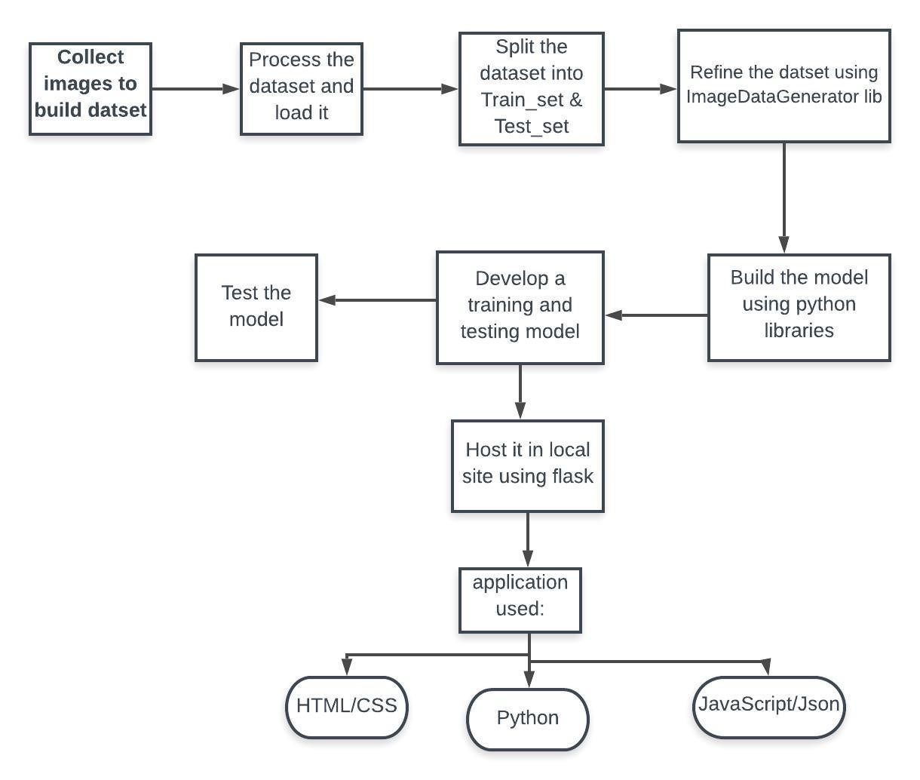
Flow chart

Slide 6
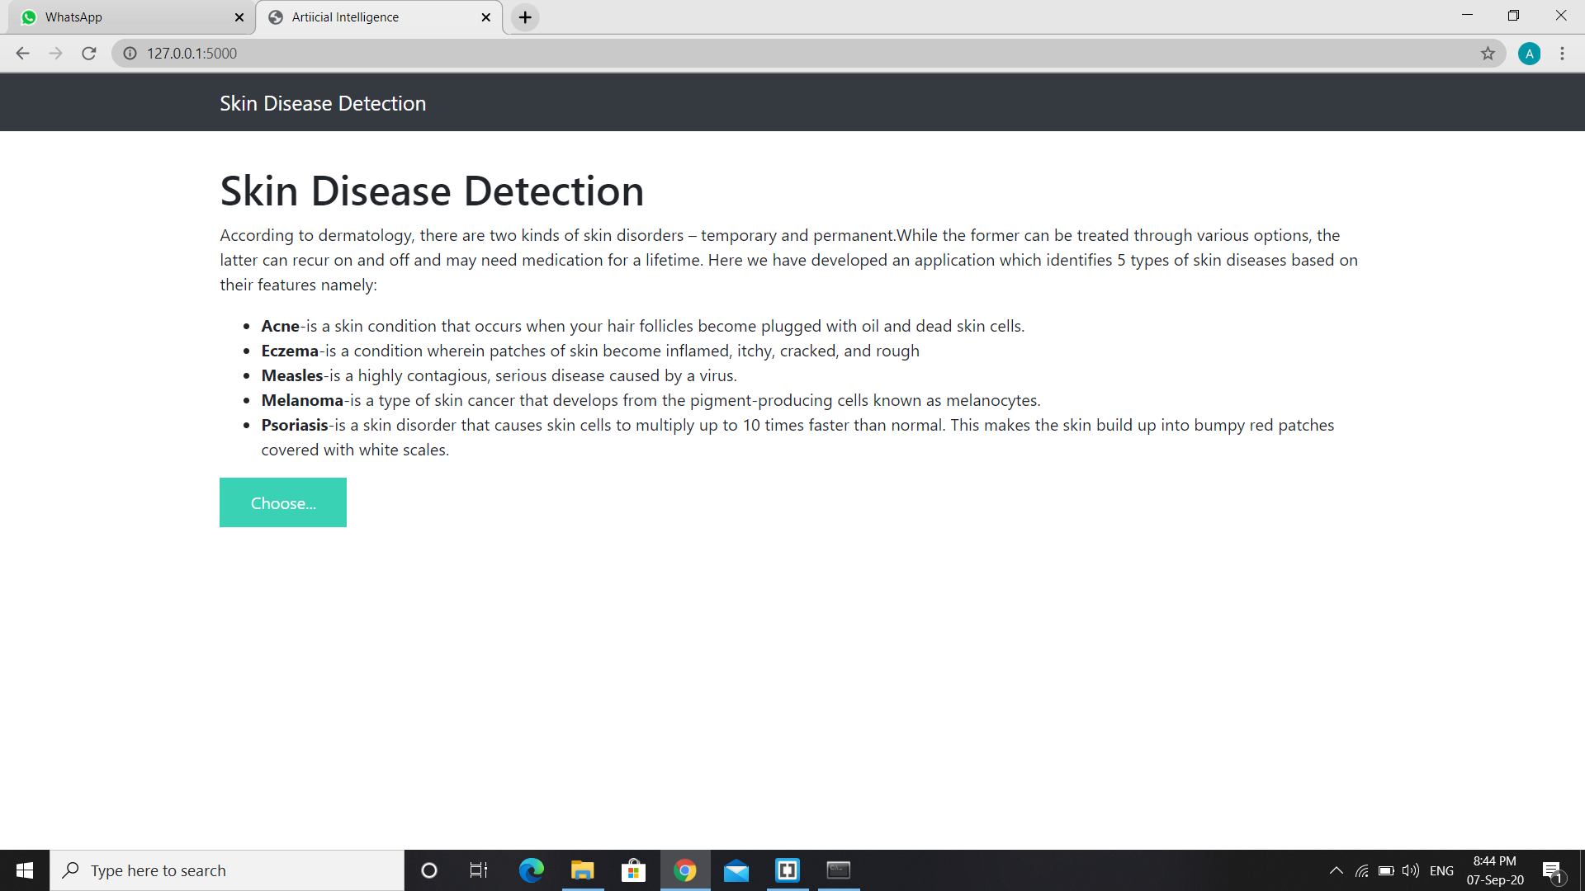
Snapshots

Slide 7
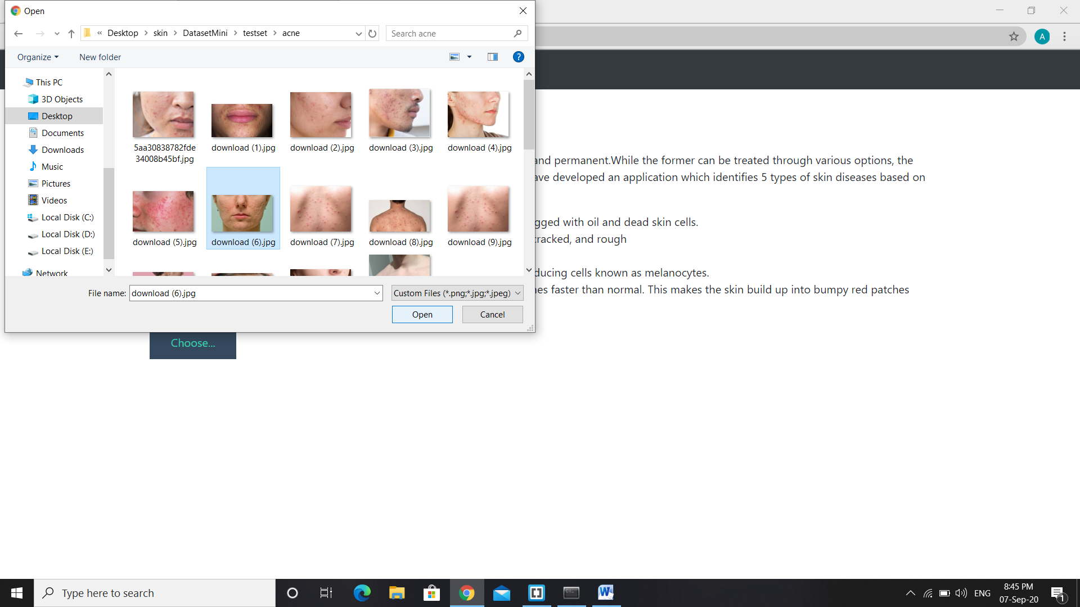
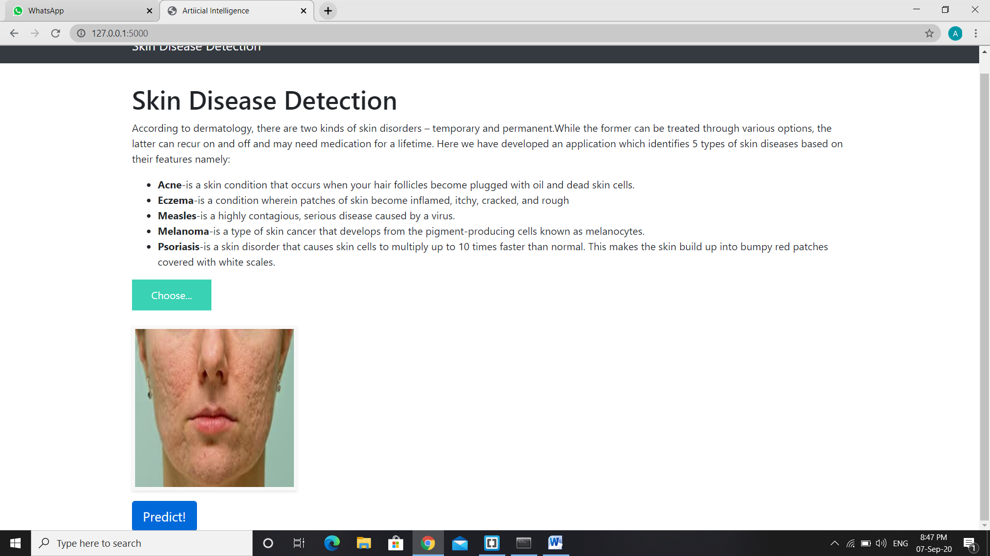

Slide 8
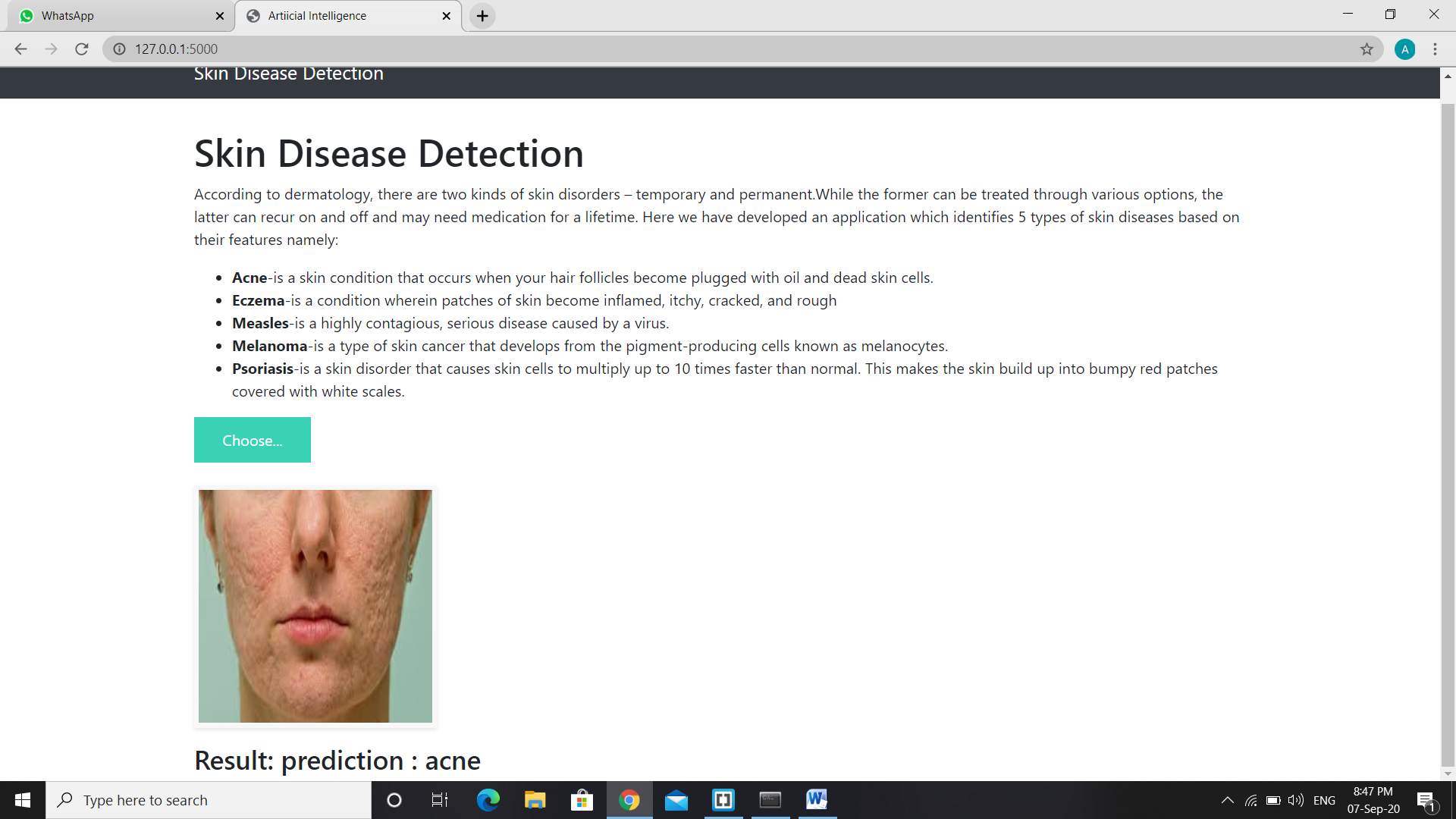

Slide 9

Benefits
This portal is not limited to only single disease prediction, it works for multiple skin diseases
It provides faster, correct output with high accuracy.
This portal enables the patient to detect the skin disease which he is suffering without consulting doctor just by uploading an image.
Perfect prediction of the skin disease patient is suffering from.
Extremely easy to use and understand.
Can be used a First-aid just by uploading the photo of infected area.
Straight forward result with automatically Net search result for better supervisions.

Slide 10

Result
Designed an AI model that correctly identifies the type of skin disease even after analyzing an input image. It is easy to use and can be used for any sort of skin disease.

Slide 11

conclusion
In this work a model for prediction of skin diseases is done using deep learning algorithms. It is found that by using the ensembling features and deep learning we can achieve a higher accuracy rate and also we can go for the prediction of many more diseases. By implementing deep learning algorithm we are able to predict 5 diseases with a higher accuracy level. This proves that deep learning algorithms have a huge potential in the real world skin disease diagnosis. If even a better system with high end system hardware and software with a very large dataset is used the accuracy can be increased considerably and the model can be used for clinical experimentation as it does have any invasive measures. Future work can be extended to make this model a standard procedure for preliminary skin disease diagnosis method as it will reduce the treatment and diagnosis time.

Slide 12

Thank you

